Slide 1
Vehicle Database
By Warvin Hassan

Slide 2
Questions Answered & Dataset Used
Which companies contribute emissions greater than the average?
_________________________________________________________
Why Vehicles?
Mock data generated using ChatGPT.
Messy Data, inaccuracies, and other issues.

Slide 3
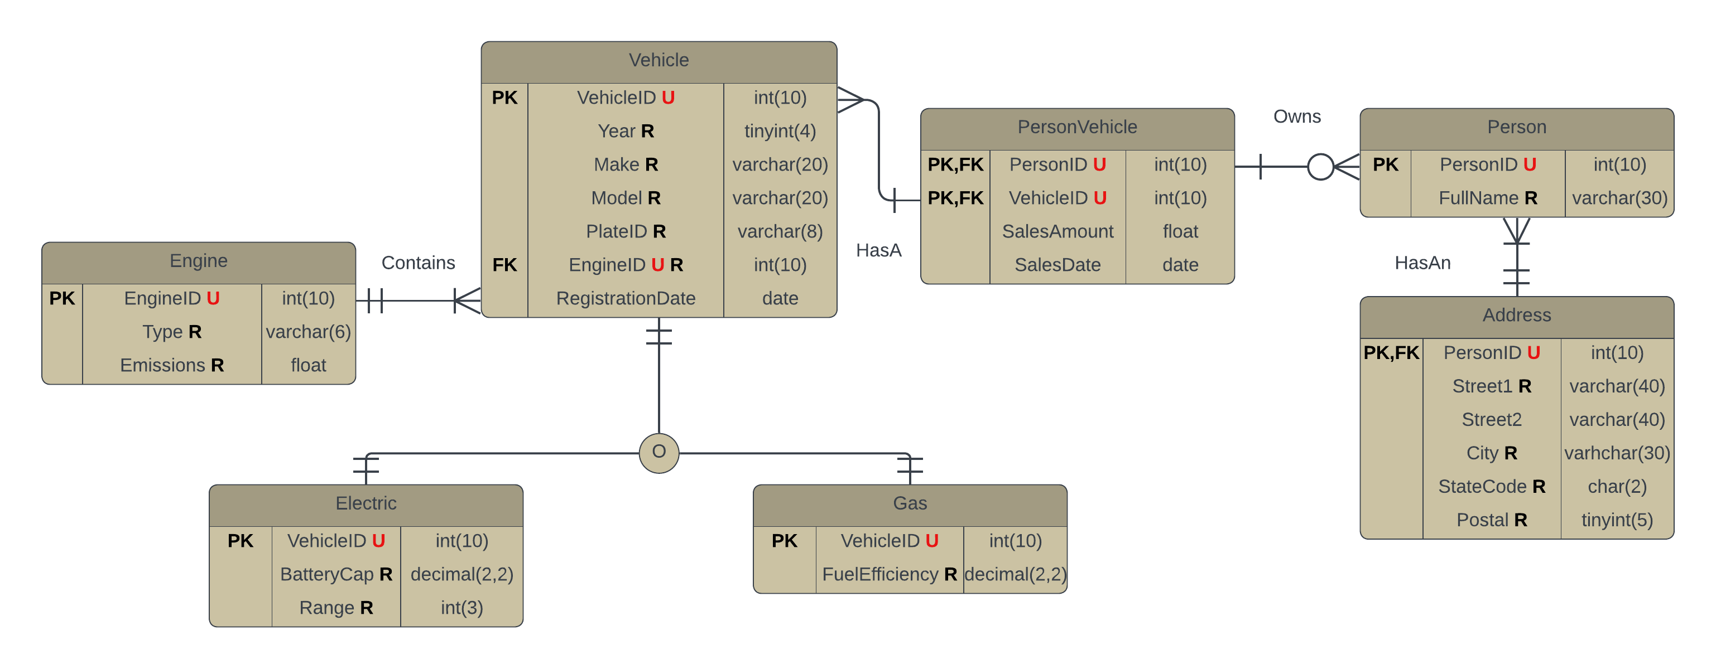
Database Structure and Challenges

Slide 4
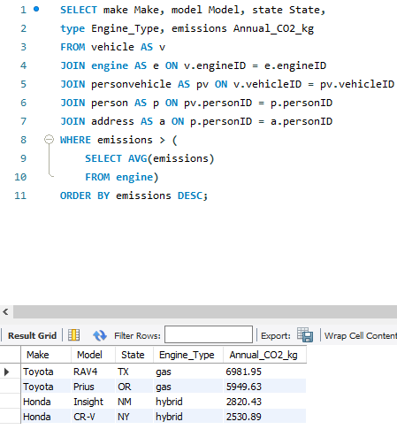
SQL Queries and Results

